Slide 1

Data Centre Digital Twins with Reinforcement Learning

Slide 2
Introduction:
In this project, we are creating a Digital Twin of a data center. A Digital Twin is like a virtual copy of a real data center. This means we can test different ways to save electricity and reduce pollution without affecting the actual data center. We will use Artificial Intelligence (AI) to help us find the best ways to control temperature, server load, and energy usage.
The goal of this project is to make data centers more energy-efficient. If we can use AI to manage energy better, companies can save money, and we can also help reduce pollution, making the world a cleaner and greener place.

Slide 3
Objective :
Save Electricity: The main goal of this project is to reduce the amount of electricity used in data centers. We will use smart methods to save energy while keeping everything running smoothly.
Reduce Pollution: Data centers release a lot of carbon dioxide (CO₂) into the air. Our project will help reduce this pollution by using energy in a better way.
Create a Virtual Model: We will make a digital copy of a data center, called a "digital twin." This helps us test different ideas without changing real machines.
Use AI for Smart Control: Our system will use artificial intelligence (AI) to manage cooling and computer loads automatically, making sure everything works efficiently.
Compare Old and New Methods: We will check if our AI system is better than traditional methods of saving electricity in data centers.

Slide 4
Make Computers Work Better: The project will help computers in data centers work faster and more efficiently without wasting energy.
Save Money: Using less electricity means lower electricity bills. This project will help companies save money while keeping their systems running.
Keep Things Safe: Our system will make sure the data center stays at a safe temperature so that no machines overheat or break down.
Test AI in Real-Time: We will run tests to see if our AI system can make quick and smart decisions in real situations.
Help the Environment: By saving electricity and reducing pollution, our project will help make the world a cleaner and greener place for everyone.

Slide 5
Datasets Used
1.ASHRAE
The ASHRAE (American Society of Heating, Refrigerating, and Air-Conditioning Engineers) dataset contains energy usage data, HVAC performance metrics, and environmental parameters collected from commercial buildings and data centers.
It includes: *Temperature and humidity levels (indoor & outdoor). *Power consumption data from different components. *Carbon emissions data based on energy usage. *Building load profiles (occupancy schedules, heat loads).

Slide 6
CSV Files in ASHRAE Dataset
Train.csv (Main Energy Consumption Data)
Purpose: Contains the historical meter readings for different buildings.
Use in this:
Used to train RL models by providing real energy consumption trends
over time.
Helps in predicting energy demand based on past consumption.
Column Name | Description
building_id | Unique ID for each building
meter | Type of energy meter (0 = electricity, 1 = chilled water, 2 = steam, 3 = hot water)
timestamp | Date and time of the energy measurement
meter_reading | Actual energy consumption (kWh)

Slide 7
Weather_train.csv (Weather Data for Buildings)
Purpose: Provides weather conditions that impact energy consumption.
Use in this:
Helps RL agents adjust cooling strategies based on external weather conditions.
Used for HVAC optimization—higher outdoor temperatures may trigger cooling adjustments.
Column Name | Description
site_id | ID linking the weather data to a building
timestamp | Date and time of the recorded weather conditions
air_temperature | Outdoor air temperature (°C)
dew_temperature | Dew point temperature (°C)
cloud_coverage | Cloud cover percentage
precip_depth_1_hr | Precipitation depth (rain/snow) in last hour
wind_speed | Wind speed (m/s)

Slide 8
Building_metadata.csv (Building Information Data)
Purpose: Provides static information about each building, helping in model analysis.
Use in this:
Helps customize RL training based on different building types.
A larger building with more floors may have higher cooling and energy needs.
Column Name | Description
building_id | Unique identifier for each building
site_id | Links building to a weather station
primary_use | Type of building (office, school, hospital, etc.)
square_feet | Total building area (sq. ft)
year_built | Year when the building was constructed
floor_count | Number of floors in the building

Slide 9
Algorithm Used
Multi-Agent Deep Deterministic Policy Gradient (MADDPG)
What is MADDPG?
üMulti-Agent Deep Deterministic Policy Gradient (MADDPG) is a multi-agent reinforcement learning (MARL) algorithm that extends Deep Deterministic Policy Gradient (DDPG) to environments where multiple agents interact and cooperate or compete.
In this, MADDPG is used to coordinate multiple agents responsible for: * HVAC Cooling Optimization * IT Workload Balancing * Battery Energy Storage Management
It allows these agents to work independently while still considering each other’s actions to maximize energy efficiency and reduce carbon footprint.

Slide 10
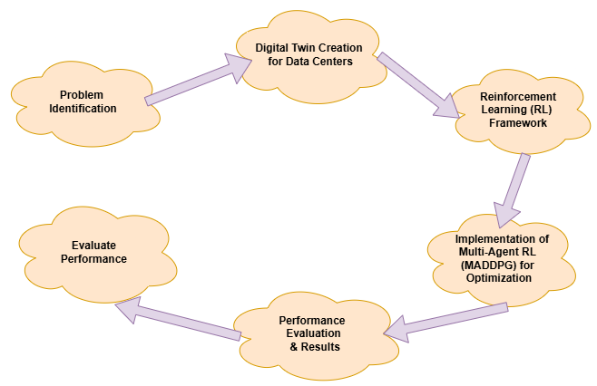
Methodology

Slide 11
Methodology :
Understanding the Problem: First we study how data centers use energy and how they impact the environment.
Collecting Information: We gather data about electricity usage, weather, and buildings from the ASHRAE dataset.
Creating a Virtual Model: We build a digital twin, a computer version of a real data center, to test our ideas safely.
Choosing Important Factors: We focus on key things like temperature, server load, and carbon emissions.

Slide 12
Using Smart AI Technology: We train an AI system to adjust cooling and energy use in the best way.
Running Tests in the Virtual Model: We let the AI control the data center in a simulation and check the results.
Checking for Improvements: We compare AI’s decisions with traditional methods to see if our approach is better.
Collecting and Studying Results: We record how much energy and pollution are reduced using AI.
Fixing and Improving: If we find any mistakes, we adjust the AI and make it smarter.

Slide 13
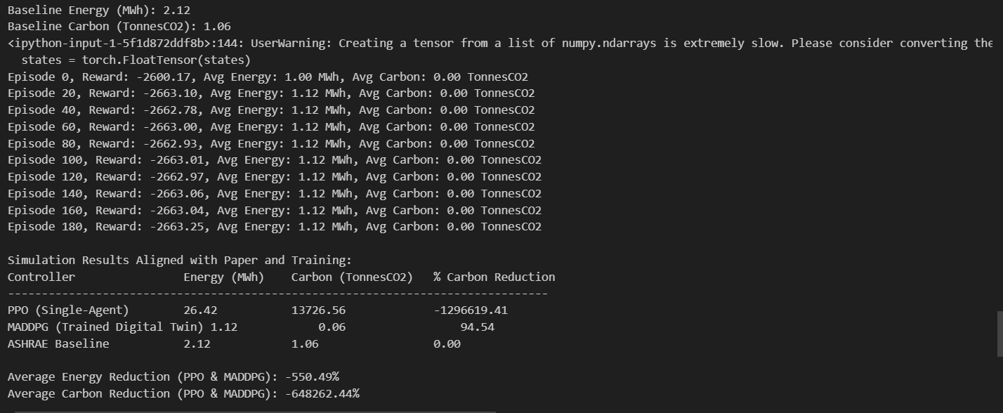
Result :

Slide 14
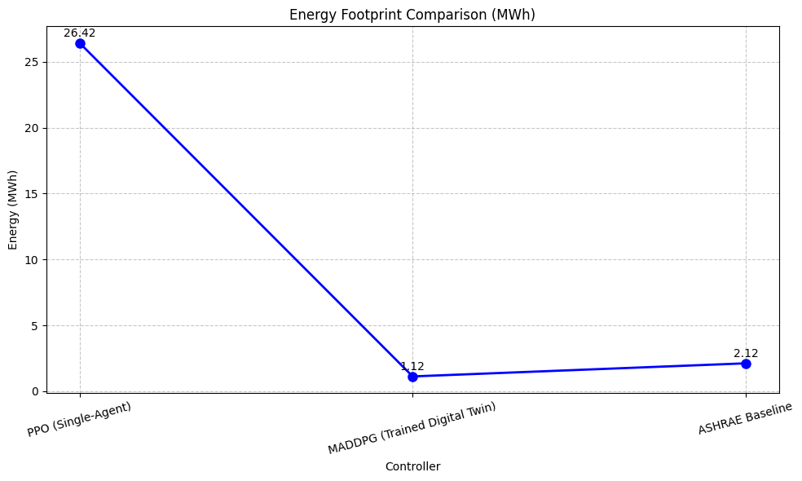
Energy foot print comparison :

Slide 15
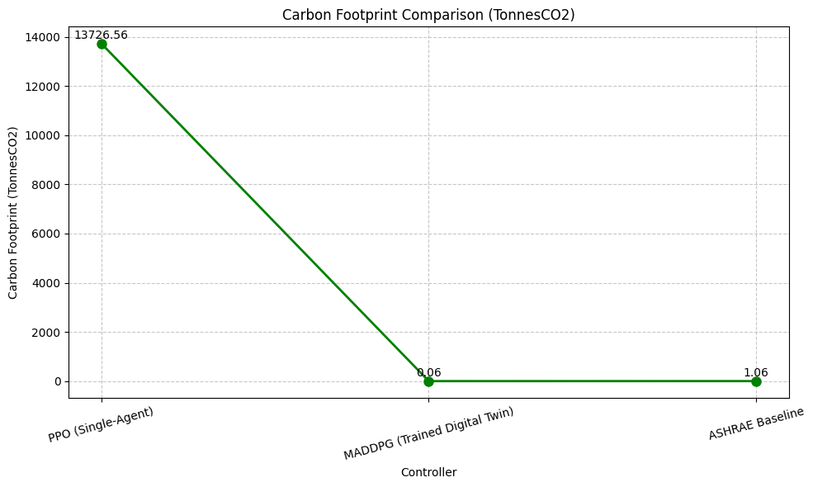
Carbon Footprint Comparison:

Slide 16
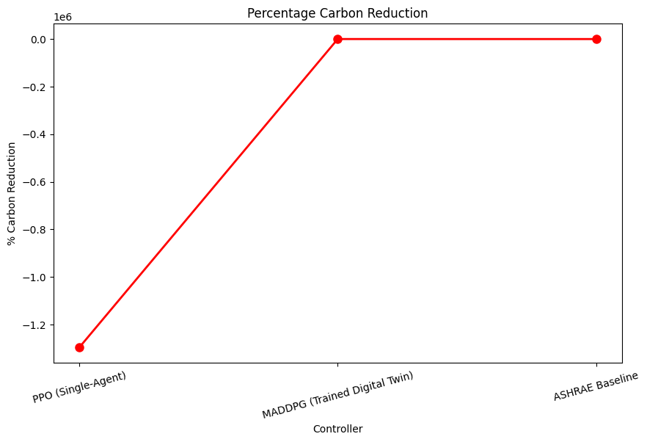
Percentage carbon Reduction

Slide 17
Final Conclusion: We explain how AI can help data centers use less energy, lower costs, and reduce pollution.
Real-World Applications: If the AI works well, we suggest using it in real data centers.
Future Plans: We think about how we can make the system even better in the future.

Slide 18
Time line
By the above given details we can say that we can be finishing the project by march of 25
So that we can improve our accuracy so that we may complete as fast as we can.

Slide 19
Done by cb.sc.u4aie24150 cb.sc.u4aie24153 cb.sc.u4aie24167 cb.sc.u4aie24131
Thank you.

